Slide 1

Presentation On
An Overview Of Beximco Pharmaceuticals Ltd.
Presented By:
Habiba Akter Keya
Batch:41
Roll:01-041-24
Department: Management Studies
Submitted Date:
07-12-2024

Slide 2
Overview
Product/Service
Analysis
Conclusion

Slide 3
Overview
Product/Service
Analysis
Conclusion

Slide 4
Beximco Pharmaceuticals Ltd.
Beximco Pharmaceuticals Ltd. (Beximco Pharma) is an emerging generic drug player committed to providing access to affordable medicines. Company’s state-of-the-art manufacturing facilities have been accredited by the regulatory authorities of USA, Australia, European Union, Canada, and Brazil, among others, and it currently focuses on building presence in many emerging and developed markets around the world.
Beximco Pharma is consistently building upon its portfolio and currently producing more than 500 products encompassing broad therapeutic categories and the Company has created strong differentiation by offering a range of high-tech, specialized products which are difficult to imitate.

Slide 5
Awards
Beximco Pharmaceuticals Ltd. has won several awards, including:
SCRIP Award: Won in 2017 as the "Best Pharma Company in an Emerging Market"
Global Generics & Biosimilar Awards: Won in 2019 as "Company of the Year, Asia Pacific" and in 2021 as "Company of the Year, Asia Pacific"
CPhI Pharma Awards: Won in 2020 for "Innovation in Response to COVID-19"
Global Generics & Biosimilar Awards 2022: Won for "Acquisition of the Year"
National Export (Gold) trophy
Won the trophy six times for its contributions to pharmaceutical exports.

Slide 6
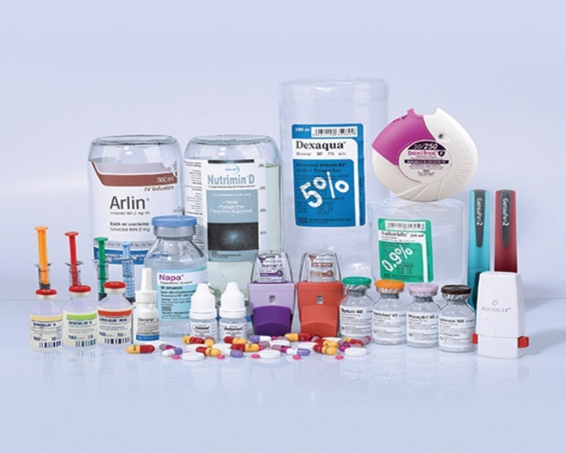
Product and Services:
Beximco Pharma currently produces more than 300 generic medicines which are available in well over 500 different presentations and the broad portfolio encompasses all key therapeutic categories including antibiotics, analgesics, anti-diabetic, respiratory, cardiovascular, central nervous system, dermatology, gastrointestinal etc.

Slide 7
Sales and cost statistics
Year | Sales | Expenses | Profit
2023 | 39267 | 30295 | 8972
2022 | 34669 | 26447 | 8222
2021 | 29494 | 22041 | 7453

Slide 8
Sales and cost statistics

Slide 9
Conclusion
The Beximco Pharma is the 3rd largest company in Pharma industry has started its journey from 1976 and began commercial production from1980. With a large amount of production it has met local demand and exported medicine internationally. With lots of key success it has some gap in quite success factors area. It has big share market but it is growing not positively than other less share marketed Pharma companies are growing very fast. It only manufactures and markets the pharmaceutical finished formulation products, large volume of Parenterals and Active Pharmaceutical Ingredients (APIs). Rather, Square Pharmaceuticals Ltd is producing herbal, nutraceutical and ayurvedic medicine. Moreover it is manufacturing and importing poultry & livestock products successfully. Beximco Pharma has research and development facilities but it should utilize more systematic and technological methods to innovate new categories product to lead in the market. It should apply most strong and successful approaches and strategies so that it can earn more profit, invest more in different industry to capture most market share in Bangladesh. Beximco Pharma is exporting its medicine around 48 countries in the world but to be most successful with global accreditation it should exports rest of countries in Asia.

